Slide 1
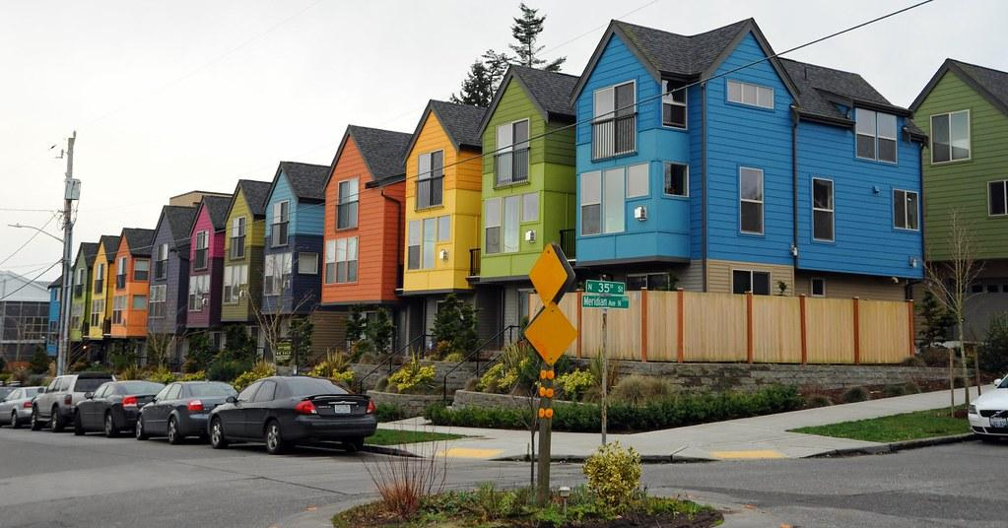
House Sales in King County, USA
House Sales in King County, USA
Deep dive on variables that affecting the housing price and housing trend in Washington State
Aaron Bossard, Harry Heublum, Mer Arnel Manahan & Hansen Xu

Slide 2
Housing Price in King County
Overview of the sample population
Data Exploration/Cleanup
Data source
Identify variables
Regression and visualization
Prediction and trend

Slide 3
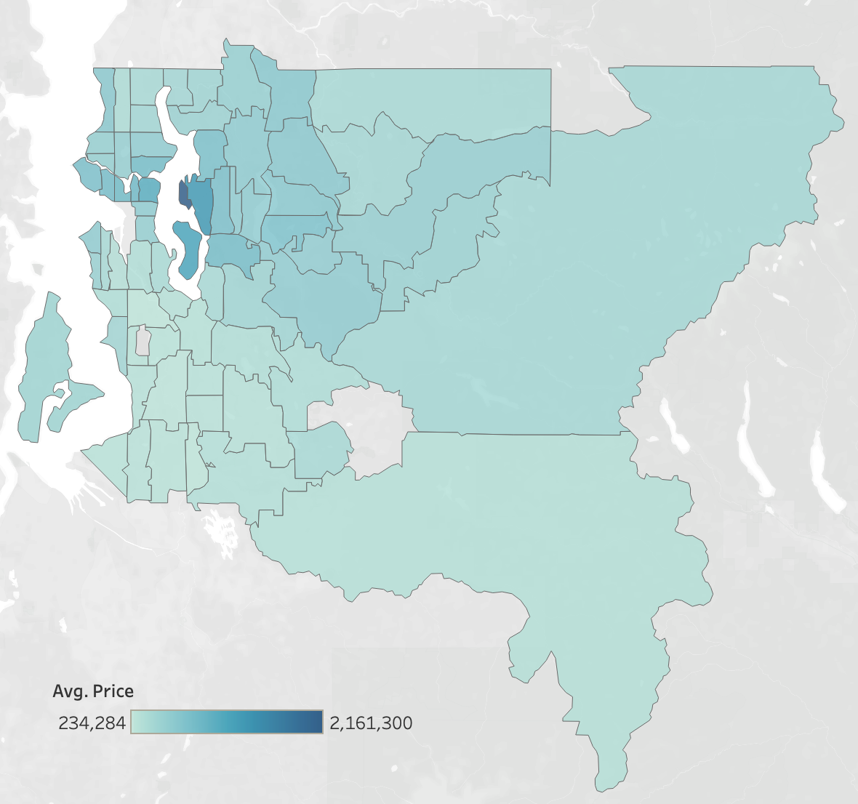
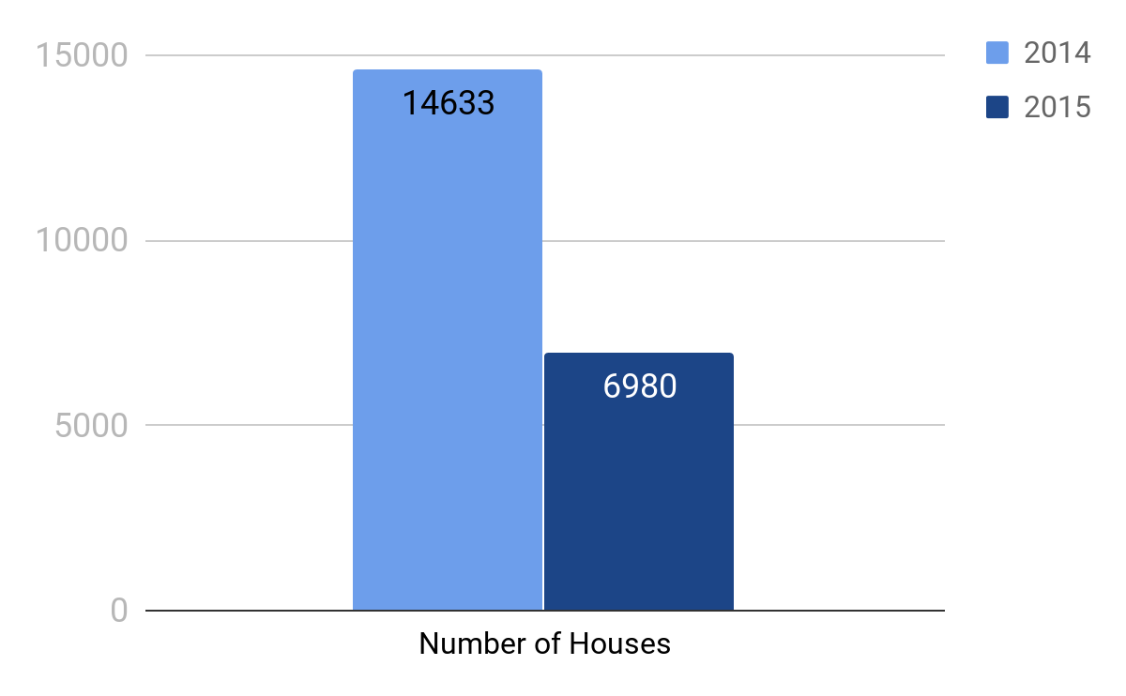
Overview
21,613 houses sold during May 2014 to May 2015
Average price range from $ 234,284 to $ 2,161,300

Slide 4
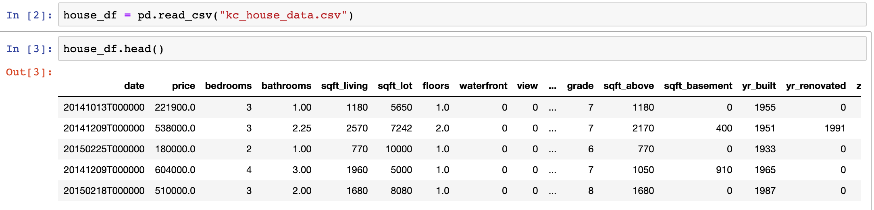
Data Cleanup
Month and Year should be parsed out for further exploratory analysis

Slide 5
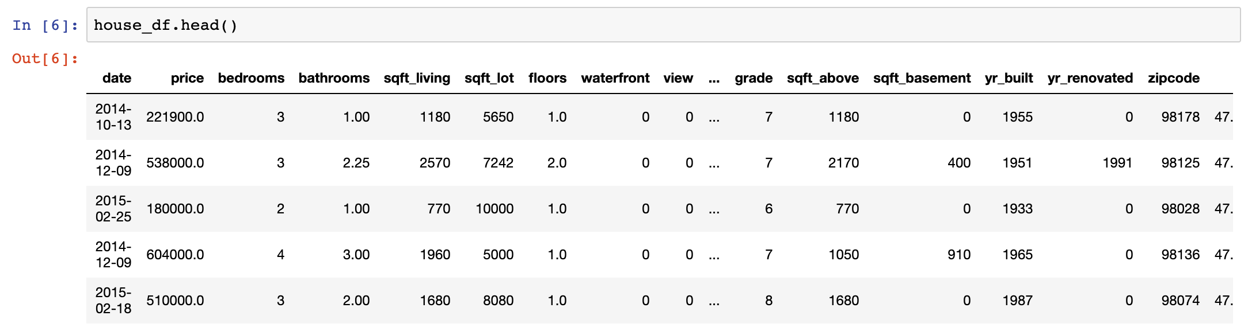
Data Cleanup
Required Dependency is ‘datetime’
Results in the following ‘date’ column

Slide 6
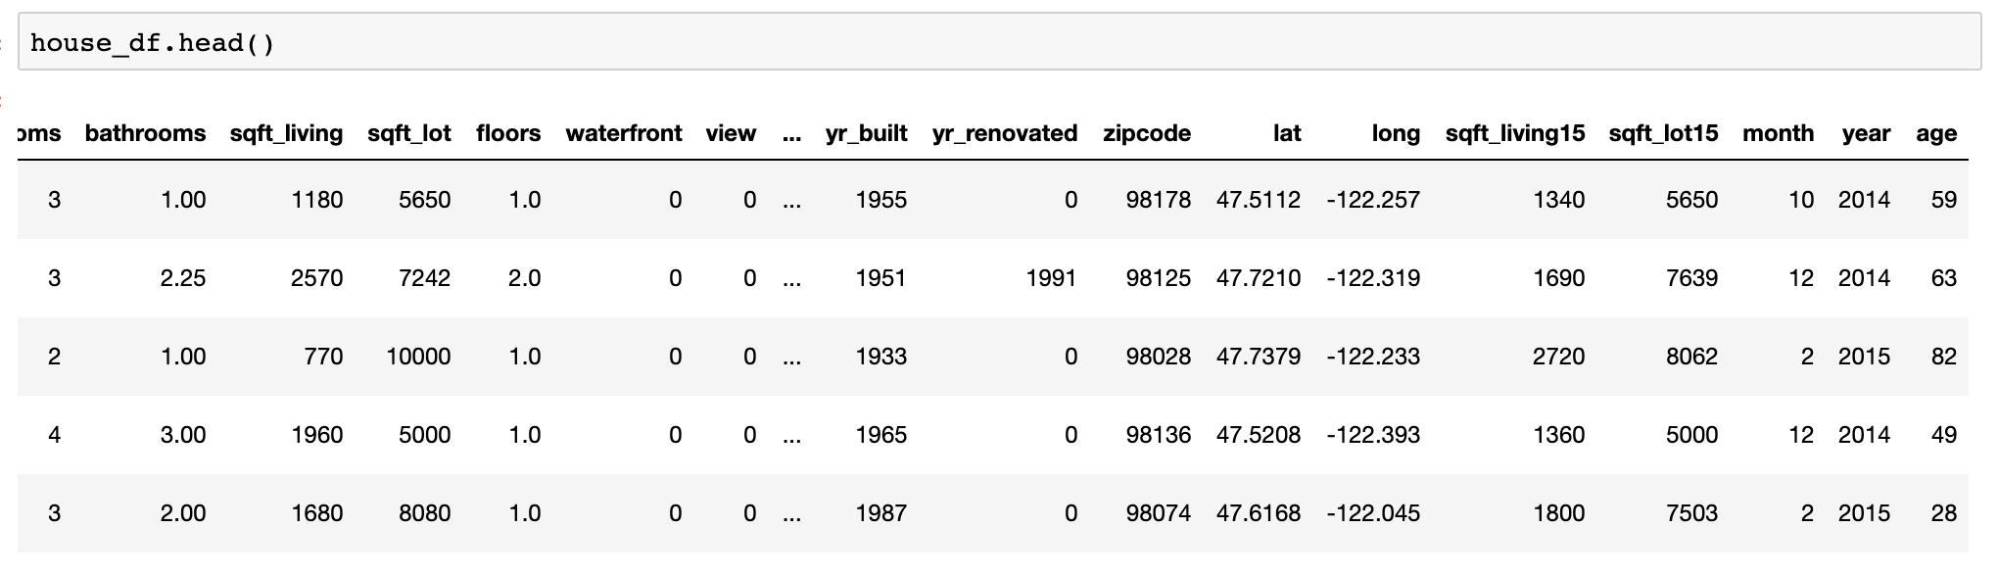
Data Cleanup
Add columns to aid in further analysis

Slide 7
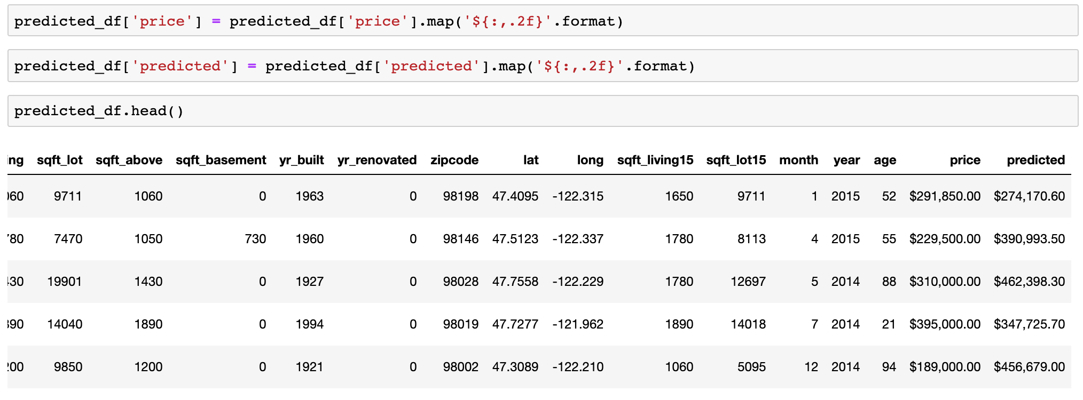
Data Cleanup

Slide 8
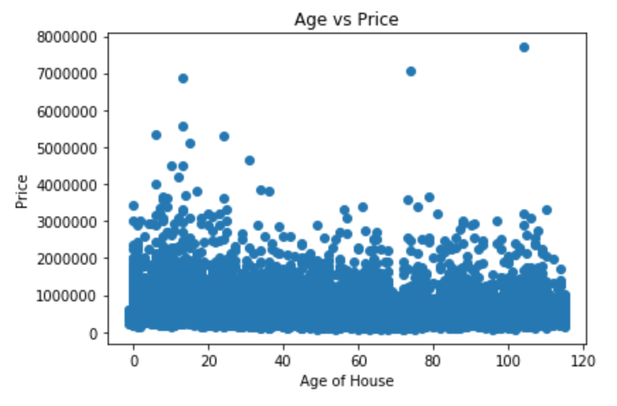
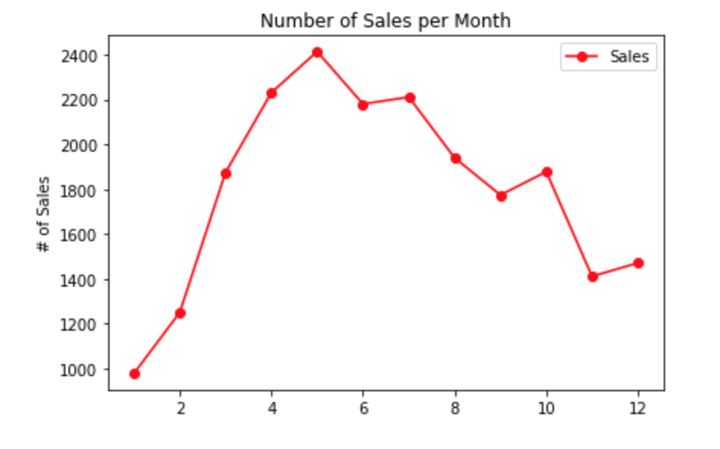
Data Exploration
Most sales happen in the end of spring and beginning of summer
Slight distinction showing higher prices for younger homes

Slide 9
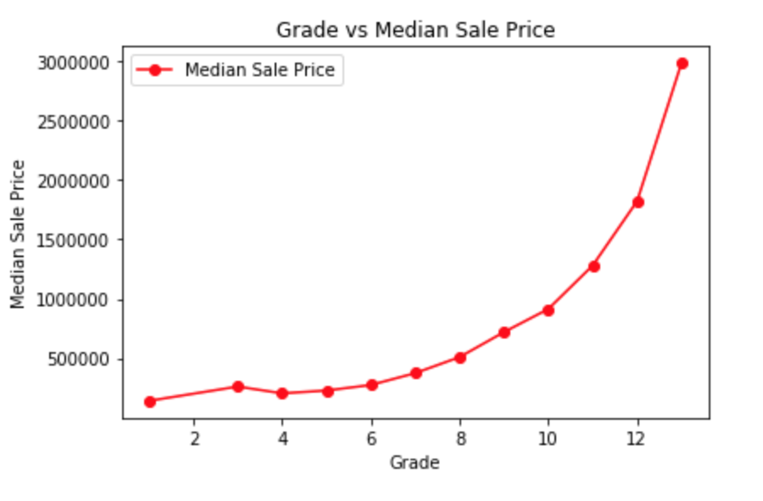
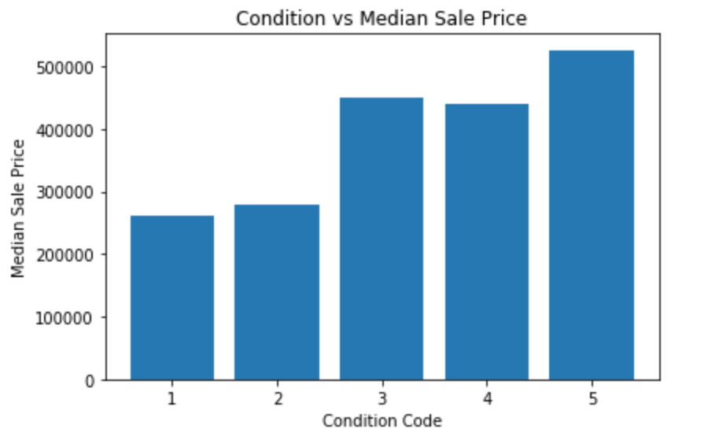
Data Exploration
As condition code and grade increase, so does the median sale price

Slide 10
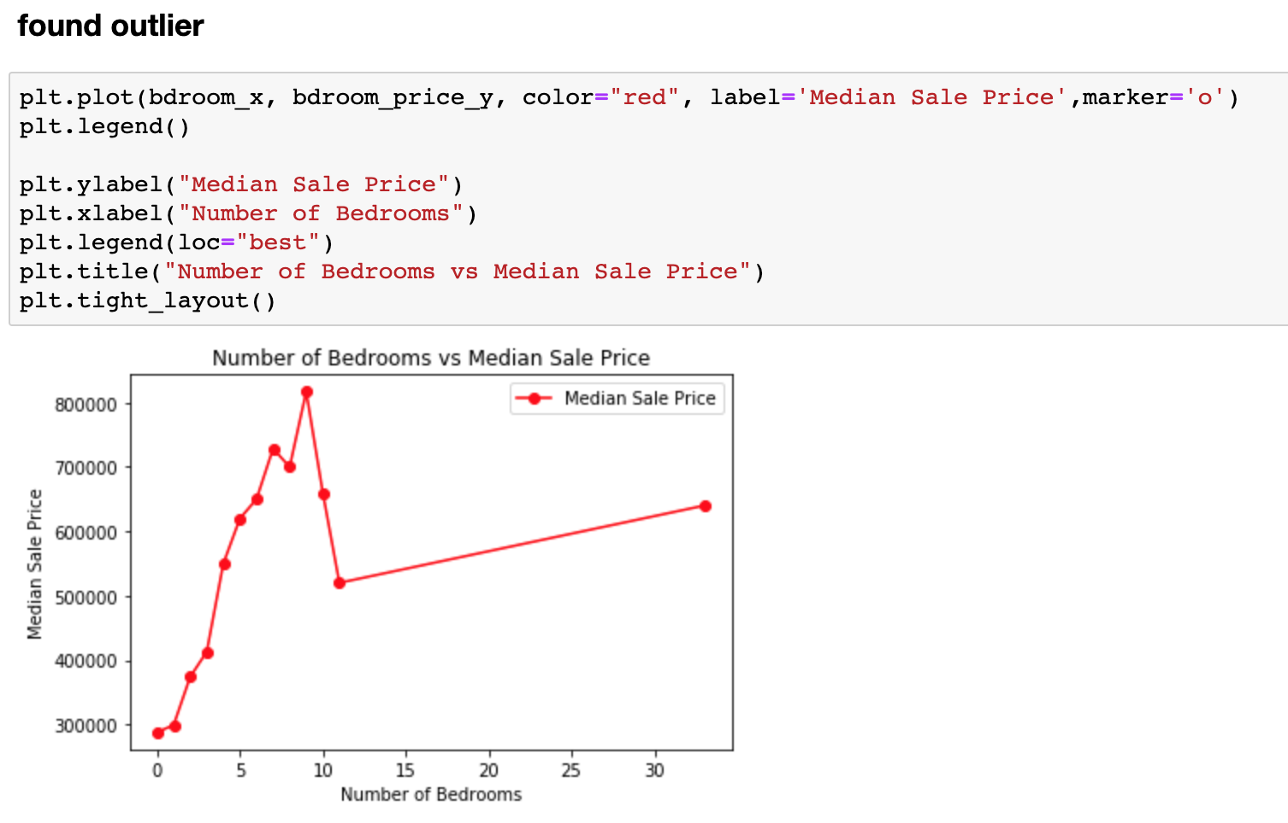
Data Exploration

Slide 11
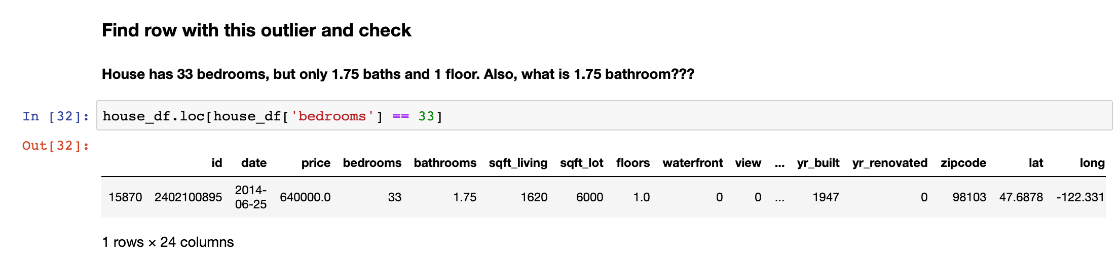
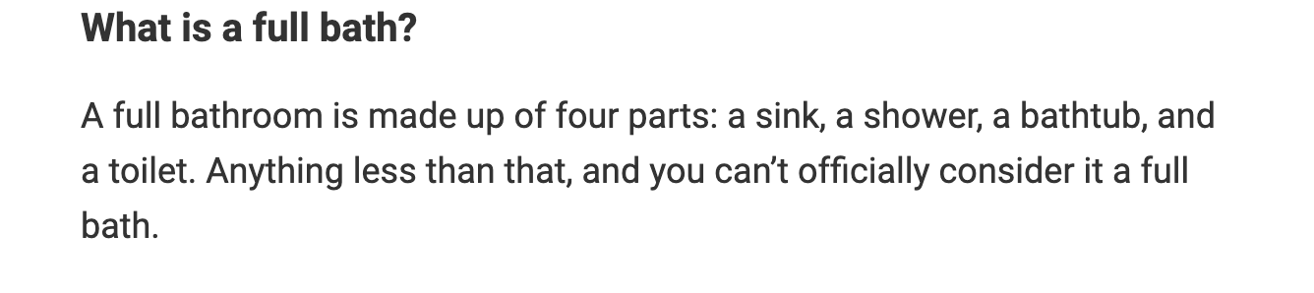
Data Exploration
www.realtor.com

Slide 12
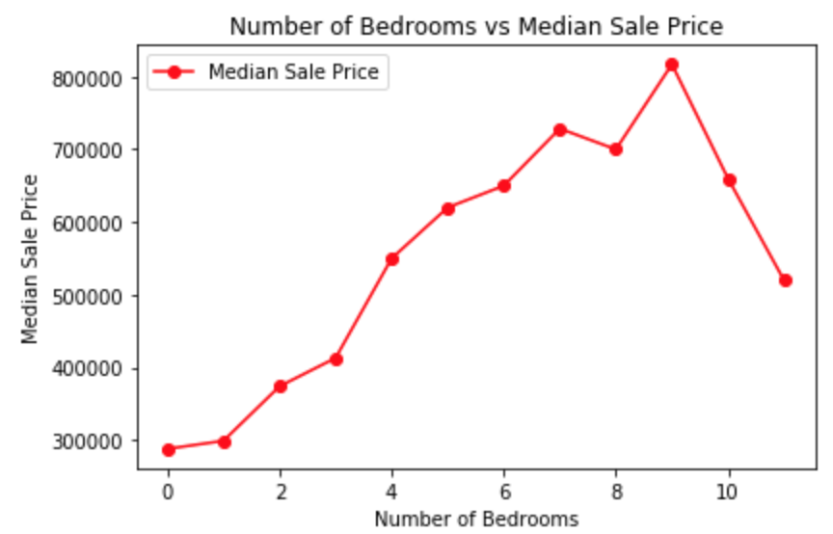
Data Exploration

Slide 13
12
Number of Bedrooms
Number of Bathrooms
Square feet of Living
Number of Floors
Waterfront
View
Grade
Square feet of Above
Square feet of Basement
Year built
2015 Square feet of Living
2015 Square feet of Lot
Total Variables

Slide 14
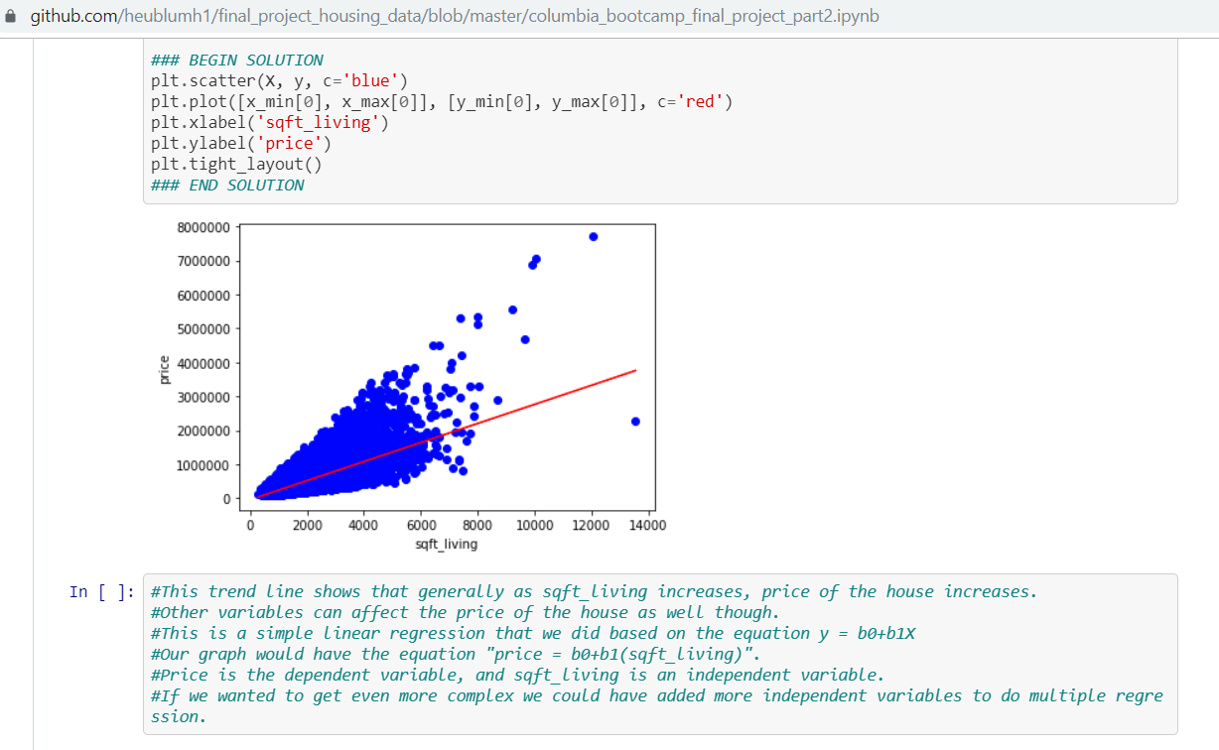
Regression comparing price and sqft_living

Slide 15
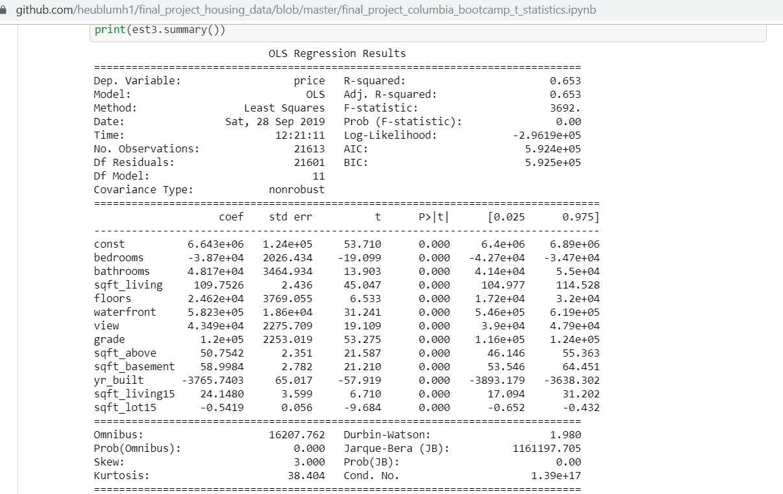
Multiple Regression - this model explains 65.3% of the variance in the dependent variable

Slide 16
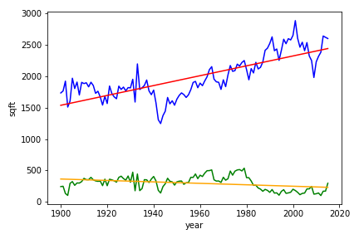
Sq Ft of Living vs Sq Ft of Basement
21,613 houses built between 1900 and 2015

Slide 17
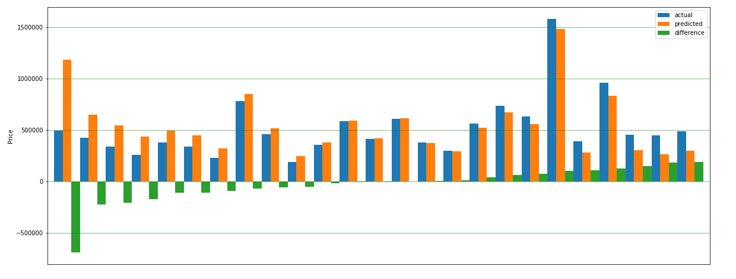
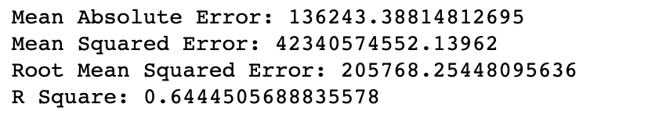
Price Prediction by Multi Linear Regression
Notes:
this model explains 64.4% of the variance in the dependent variable

Slide 18
Improvements / Next Steps
Cloud Services:
Use cloud storage for data
Perform ETL using ZEPL w/ PySpark
Host Transformed data on cloud database
Create API
Build web application to allow user to enter either square footage, number bedrooms or other features in dataset to predict housing price.

